Slide 1
Summary: In my humble opinion, riding a bike trainer is mind numbing.
Playing a flight simulator (without warping time) is equally mind numbing.
In combination, they lead to a palatable activity for me.

Slide 2

Details: Playing a flight simulator with a joystick with a throttle axis is better than
just using a keyboard and mouse.
Throttle axis

Slide 3

Details: What if a bike on a trainer could be used to control the throttle axis?
Bike on trainer; sweat guards in place.
Sweat guards prevent corrosion.
I have already replaced the bottom bracket twice!

Slide 4

Details: How could could the speed sensor on the rear wheel be used?
Speed sensor
A speed sensor is required! Above is a link to Amazon.com

Slide 5
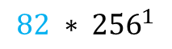

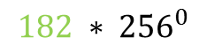

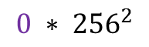
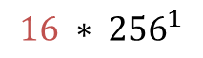
Details: When the wheel is spinning, the speed sensor transmits, with blue
tooth low energy, information on the total number of spins and angular
speed of the last spin.
Here is an 8 byte transmission (that occurs every second unless the
speed sensor stops spinning for 2 minutes) [going forward, the
transmitted information will be referred to as rawValue]:
1 ,5 ,16 ,0 ,0 ,182 ,82 ,0
The total number of rotations is the sum of
The “last event”
8
$$5 ∗ {256}^{0}$$
$$16 ∗ {256}^{1}$$
5+4096+0+0=4101
$$0 ∗ {256}^{2}$$
$$0 ∗ {256}^{3}$$
$$182 ∗ {256}^{0}$$
182+20992=21174
$$82 ∗ {256}^{1}$$

Slide 6

Details: Capturing this stream of bytes filled the programming space of an Uno
WiFi Rev2 Arduino
A second Arduino is required.
Note: The BLE signal from the speed sensor must be read by a sensor no
more than arms length away.

Slide 7
What is an Arduino?
From “opensource.com”:
In a nutshell, an Arduino is an open hardware development board that can be used by tinkerers, hobbyists, and makers to design and build devices that interact with the real world.

Slide 8


Details: These 8 bytes of information are transmitted via the wire interface
(using the ground, SCL [serial clock], and SDA [serial data] pins) to an
Arduino Leonardo that can act as joystick.

Slide 9
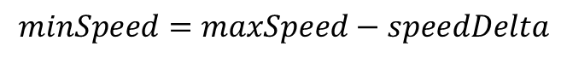
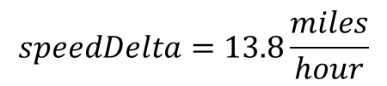
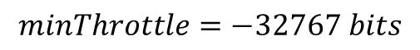
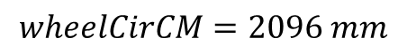
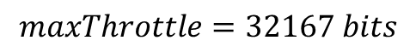
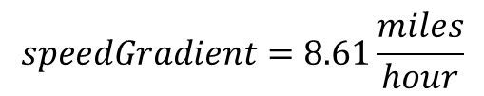
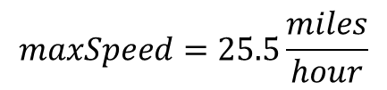
$$wheelCirCM=2096 mm$$
based on the type of tire. This for a 700CC X 22mm road tire
$$maxSpeed=25.5\frac{miles}{hour}$$
This the highest speed you could theoretically obtain after operating the trainer for a long time
$$speedDelta=13.8\frac{miles}{hour}$$
$$minSpeed=maxSpeed−speedDelta$$
$$speedGradient=8.61\frac{miles}{hour}$$
You pick this constant…help follows
$$maxThrottle=32167 bits$$
This is the highest resolution possible
$$minThrottle=−32767 bits$$

Slide 10
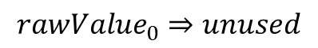
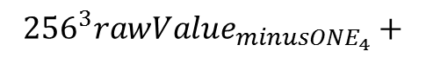
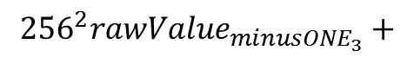
$${rawValue}_{0}⇒unused$$
$$currentRotation={rawValue}_{1}+{256}^{1}{rawValue}_{2}+{256}^{2}{rawValue}_{3}+{256}^{3}{rawValue}_{4}$$
previous$Rotation={rawValue}_{{minusONE}_{1}}+{256}^{1}{rawValue}_{{minusONE}_{2}}+$
$${{256}^{2}rawValue}_{{minusONE}_{3}}+$$
$${{256}^{3}rawValue}_{{minusONE}_{4}}+$$

Slide 11
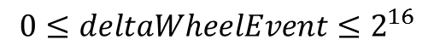
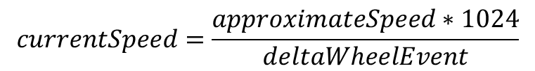
$$aproximateSpeed=\frac{\left(currentRotations−previousRotation\right)∗wheelCircm}{\left(\frac{1000mm}{m}∗\frac{1000m}{km}\right)}∗\frac{miles}{km}∗\frac{3600seconds}{hour}$$
$${wheelEvent}_{current}={rawValue}_{5}+256∗{rawValue}_{6}$$
$${wheelEvent}_{previous}={rawValue}_{{minusOne}_{5}}+256∗{rawValue}_{{minusOne}_{6}}$$
$$deltaWheelEvent={wheelEvent}_{current}−{wheelEvent}_{previous}$$
or
$$deltaWheelEvent={wheelEvent}_{current}−{wheelEvent}_{previous}+2^{16}$$
$$0≤deltaWheelEvent≤2^{16}$$
$$currentSpeed=\frac{approximateSpeed∗1024}{deltaWheelEvent}$$

Slide 12
$$distanceTravelled=\left(currentRotations∗wheelCIRCM\right)∗\frac{kilometer}{mile}∗\frac{mm}{meter}∗\frac{meter}{km}$$
$speedShouldBe=−exp\left(\frac{−distanceTravelled}{speedGradient}\right)$*speedDelta+maxSpeed
$$joystickThrottleValue=\frac{currentSpeed}{speedShouldBe}∗\left(maxThrottle−minThrottle\right)+minThrotttle$$

Slide 13
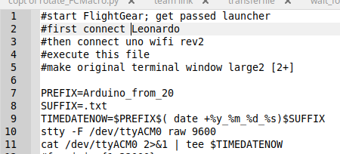
This is nerdy, and I am pretty sure the Arduinos are working even if their serial outputs are not visible, but, I like to know they are working (and how hard I am working the bike) while playing FlightGear so I wrote this Linux script.
You can also use the serial monitor on Arduino IDE to view the output from the Arduino Leonardo.

Slide 14
How are SpeedGradient, SpeedDelta, and MaxSpeed defined?
I found something that worked for me…. Below is a link to a spreadsheet
You can adjust the parameters in cells L2:L3 see how they impact an actual ride (blue dots) from their use (red line). You can copy the contents to a new sheet and replace data in column A from one of your actual rides.

Slide 15
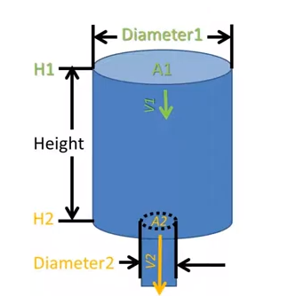
Details: Why use an exponential function?
Think of your effort on the bike trainer as a stream of water. Think of
your bike trainer as a tank for that water. That tank has a small hole at
the bottom. Water leaves that tank at a rate proportional to its height. As
time goes on, the tank will reach a constant level. That water (trainer
temperature) represents the resistance of your trainer. As time passes, the
resistance decreases and you pedal faster. This produces a differential
(i.e. difficult) equation whose solution includes an exponential function.
https://www.youtube.com/watch?v=-1ARYph3mNA

Slide 16
Quiz:
An Arduino is?
A. Small lizard indigenous to Northern Mexico
B. Hardware development circuit board
C. An alternative to salt-peter
D. Slang for a nerdy middle school student
The stream of data from a speed sensor is made up of how many bytes every second?
A. 8
B. 1
C. 64
D. 2
How many Arduinos did Todd use to transform a bike trainer into a joystick throttle axis?
A. 0
B. 1
C. 2
D. 16
What pins are used by the Arduino “Wire” library
A. SDA
B. SCL
C. Ground
D. All of the above

Slide 17
Quiz:
At most, how manty bytes of the speed sensors’ transmission are used by Todd’s Arduinos every second?
A. 64
B. 6
C. 7
D. 8
How many bytes comprise the “last event” evaluation to determine cycling speed?
A. 2
B. 4
C. 8
D. 12
Who determines when it is necessary to operate the bike’s shifters?
A. The end user decides.
B. The end user is given suggestions by the Arduino.
C. The Arduino wire library dictates this to the cyclist
D. The shifters operate through BLE

Slide 18
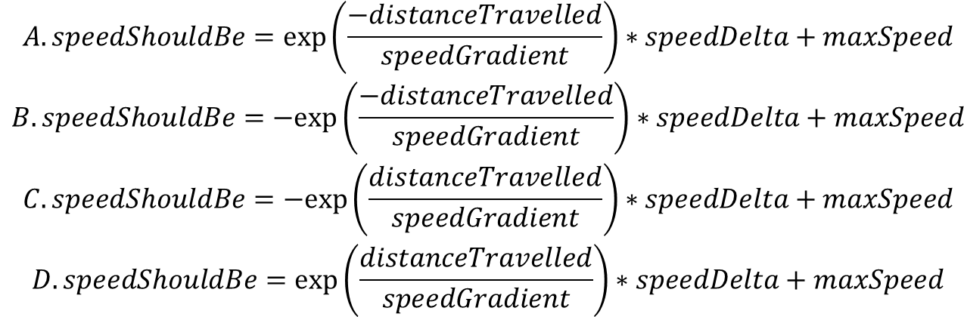
Quiz:
According to Todd, using a bike trainer by itself is:
A. Mind-numbing
B. Exhausting
C. Critical for improving short-term strength
D. Furniture, similar to a couch
The units of “speed gradient”, if distance traveled is miles, are:
A. millimeters
B. miles per hour
C. miles
D. unit less
The exponential function used by Todd to determine what the cyclists’ speed should be is:
$$\begin{matrix}A.speedShouldBe=exp\left(\frac{−distanceTravelled}{speedGradient}\right)∗speedDelta+maxSpeed \\ B.speedShouldBe=−exp\left(\frac{−distanceTravelled}{speedGradient}\right)∗speedDelta+maxSpeed \\ C.speedShouldBe=−exp\left(\frac{distanceTravelled}{speedGradient}\right)∗speedDelta+maxSpeed \\ D.speedShouldBe=exp\left(\frac{distanceTravelled}{speedGradient}\right)∗speedDelta+maxSpeed\end{matrix}$$

Slide 19
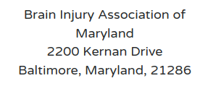
I am in debt to the Holy Spirit for gently encouraging me to move forward on this project.
If you are moved, please make a donation to:

Slide 20
Thing left to do:
add slides to show how to define speedDelta, maxSpeed, speedGradient
what is an Arduino?
make a quiz
make a box for Arduinos
order USB cables
email Bryan Pugh about presenting next year
offer CEUs to other PEs
oring for speed sensor
Can spread sheet be embedded in Windows 8?

